Slide 1

Project Members:
Matt Lewis (ML789)
Suraj Shrestha(Suraj567255)
Raelyn Sangil (RPSangil)
Thomas Gosper (Gosper23)
Notes:
Matt

Slide 2
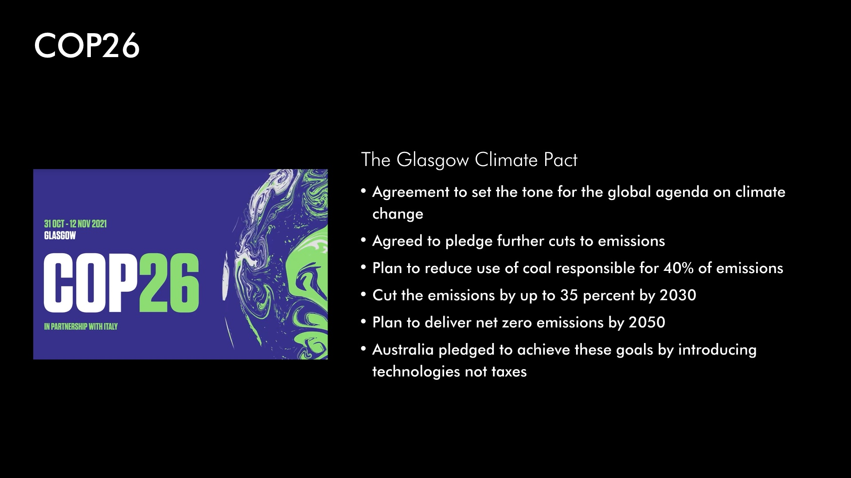
Notes:
Matt

Slide 3
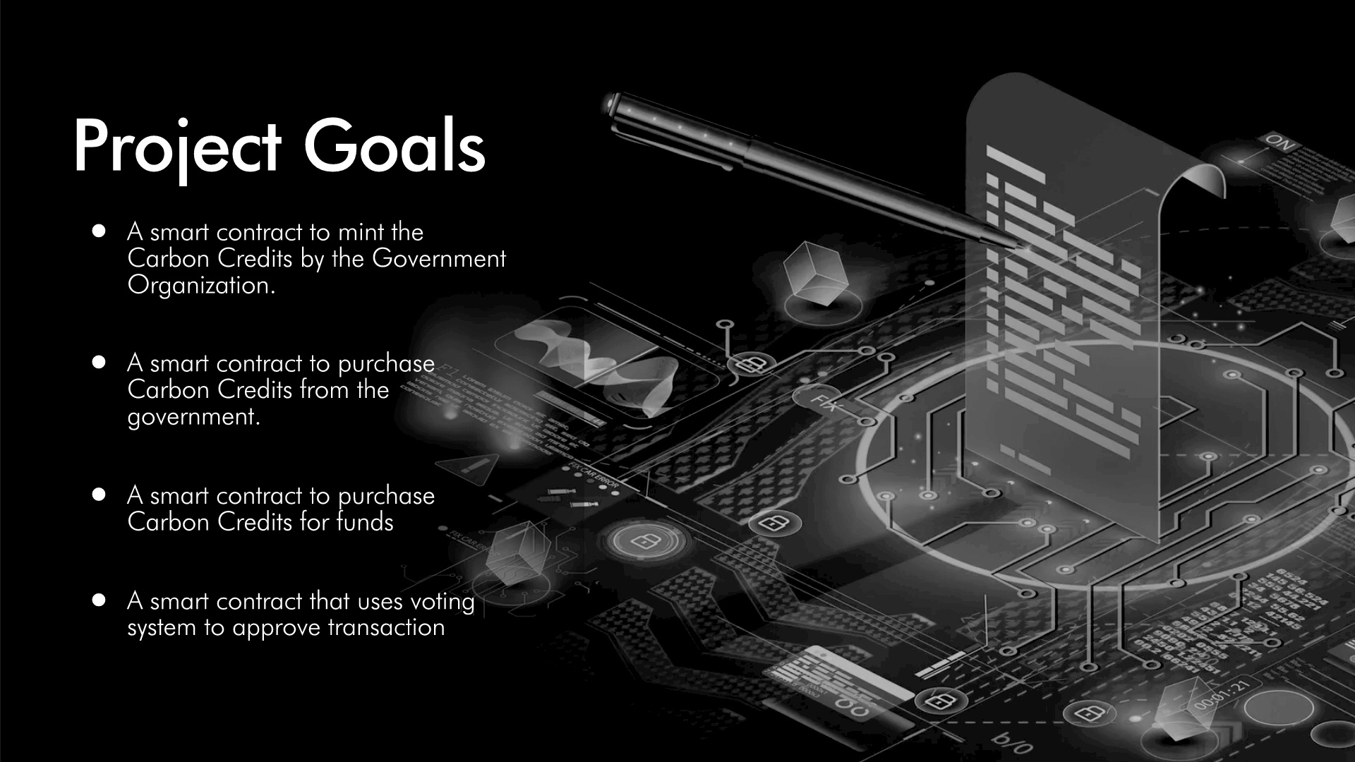
Notes:
Matt

Slide 4
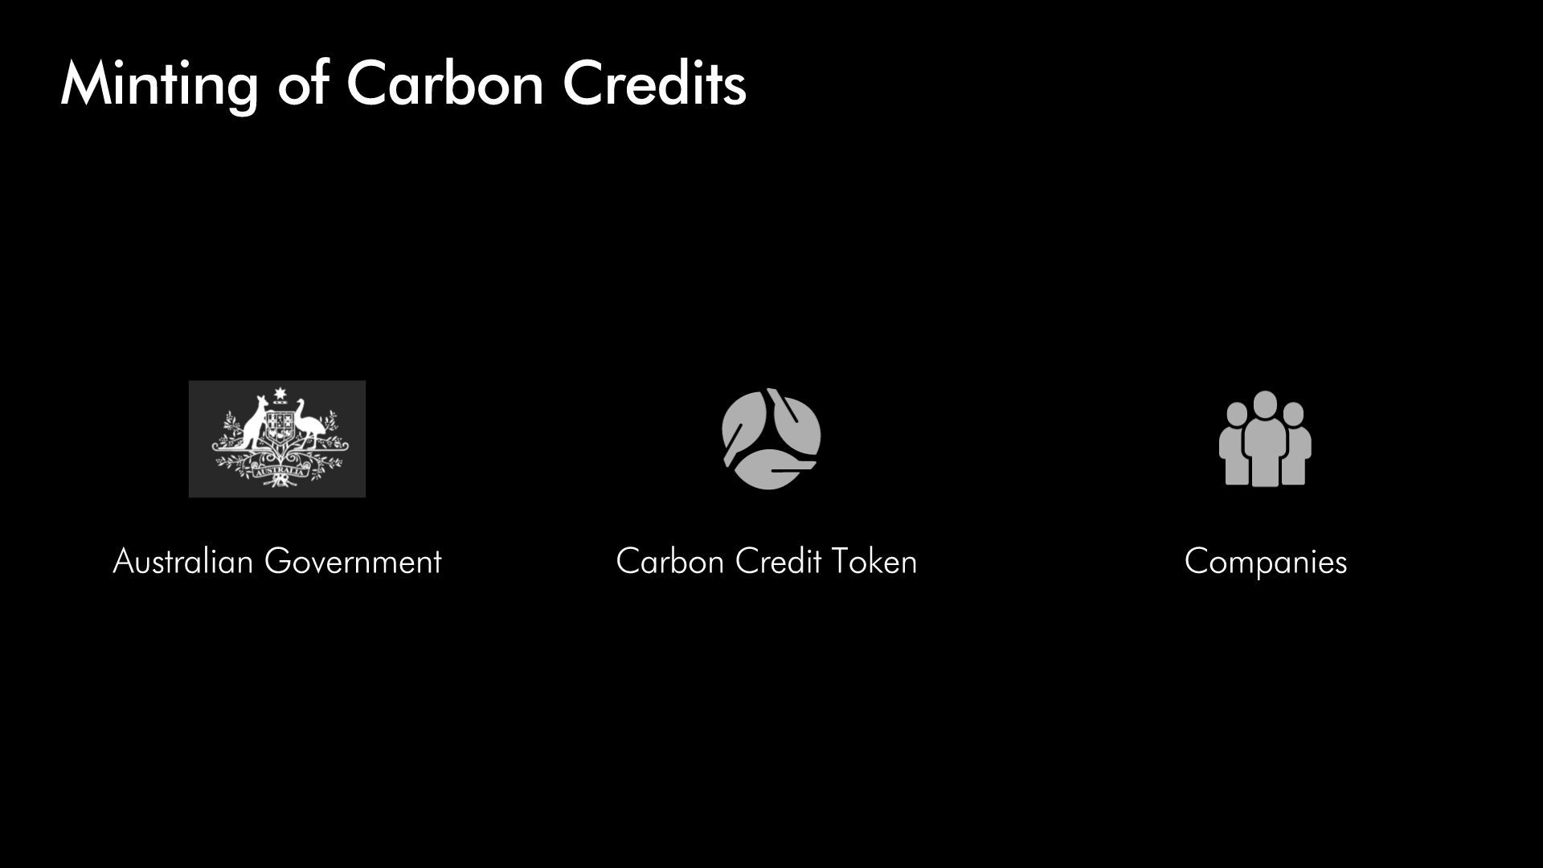

Process Applications
Notes:
Tom

Slide 5
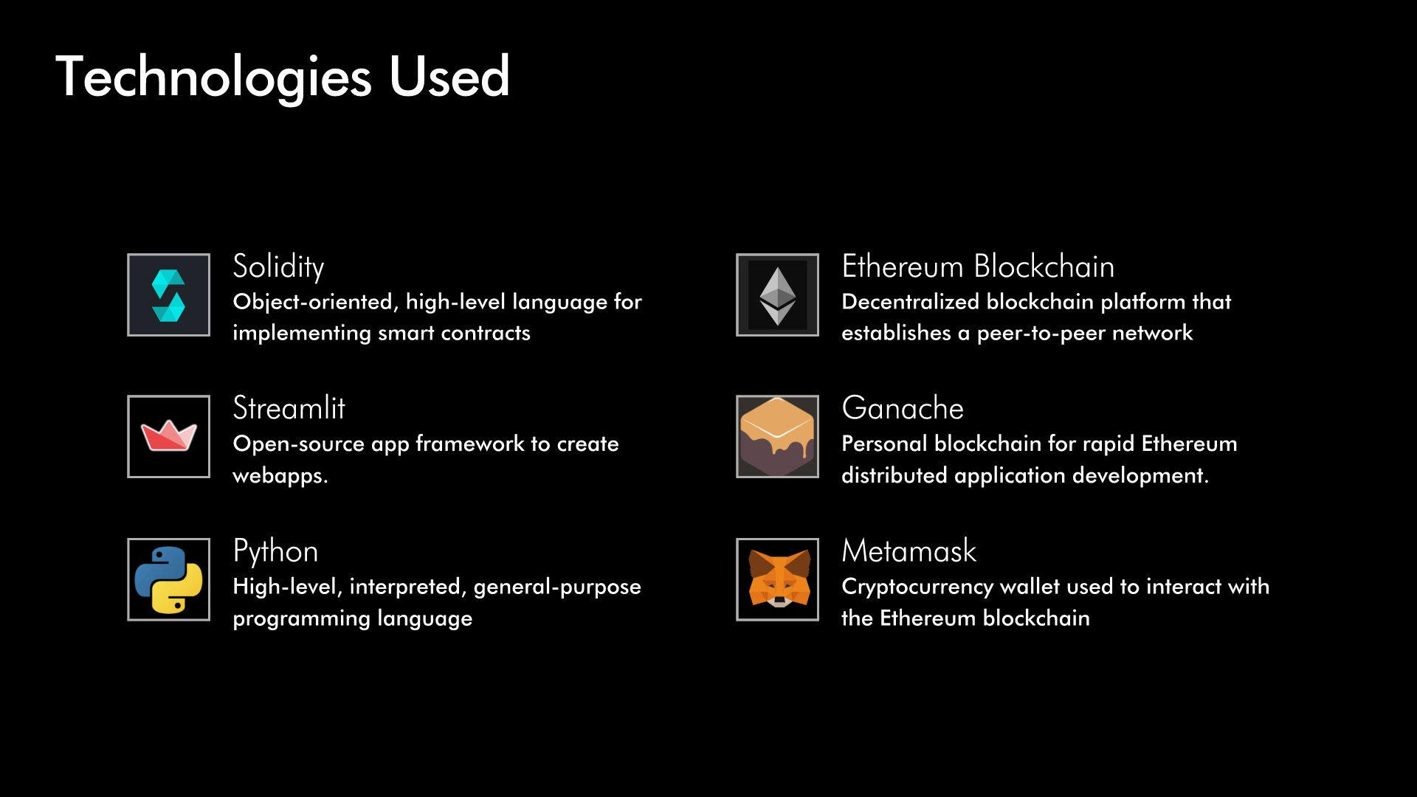
Notes:
Thomas

Slide 6
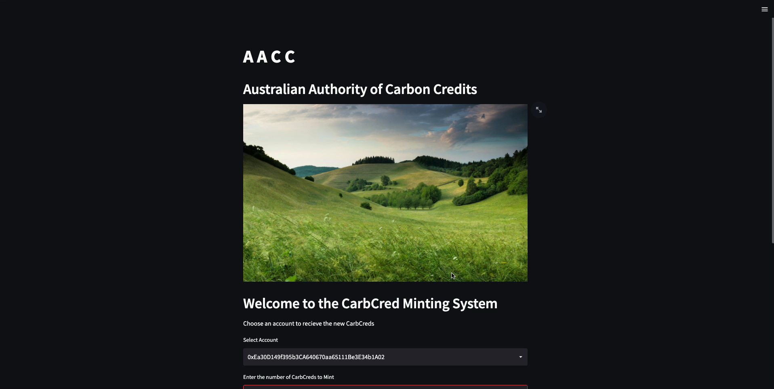
Notes:
Tom

Slide 7

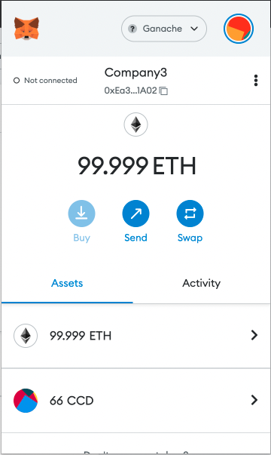
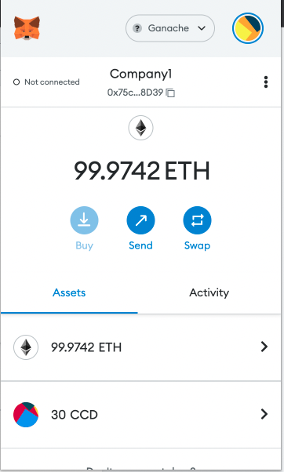
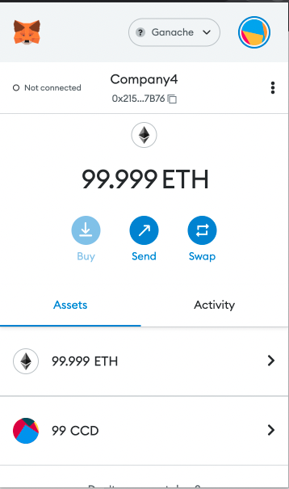
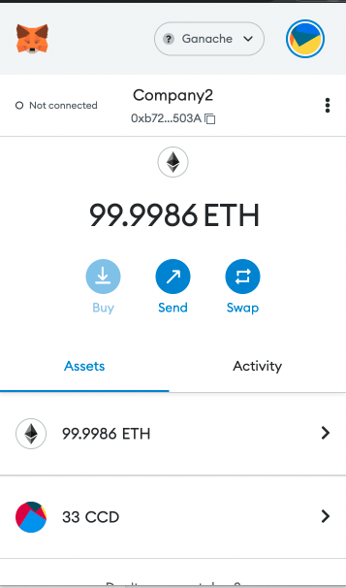
Metamask Screenshots
Notes:
Tom

Slide 8
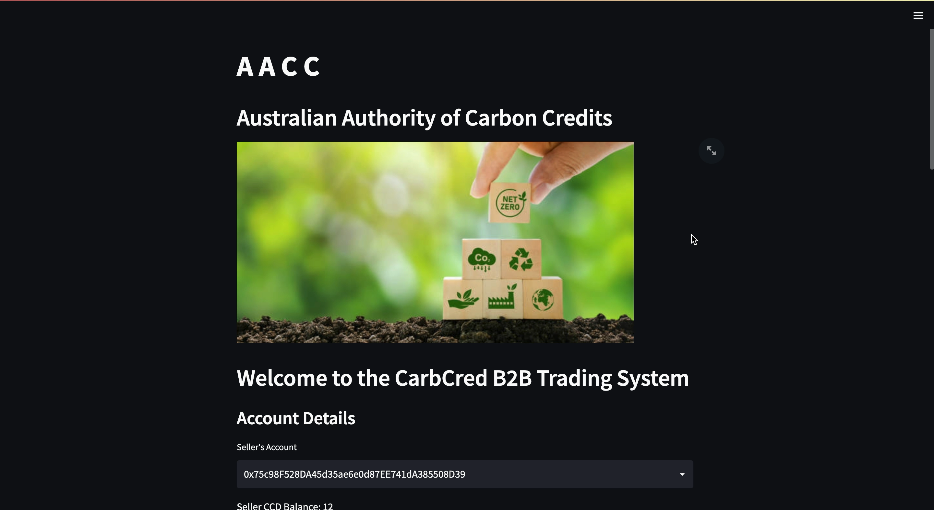
Notes:
Tom

Slide 9
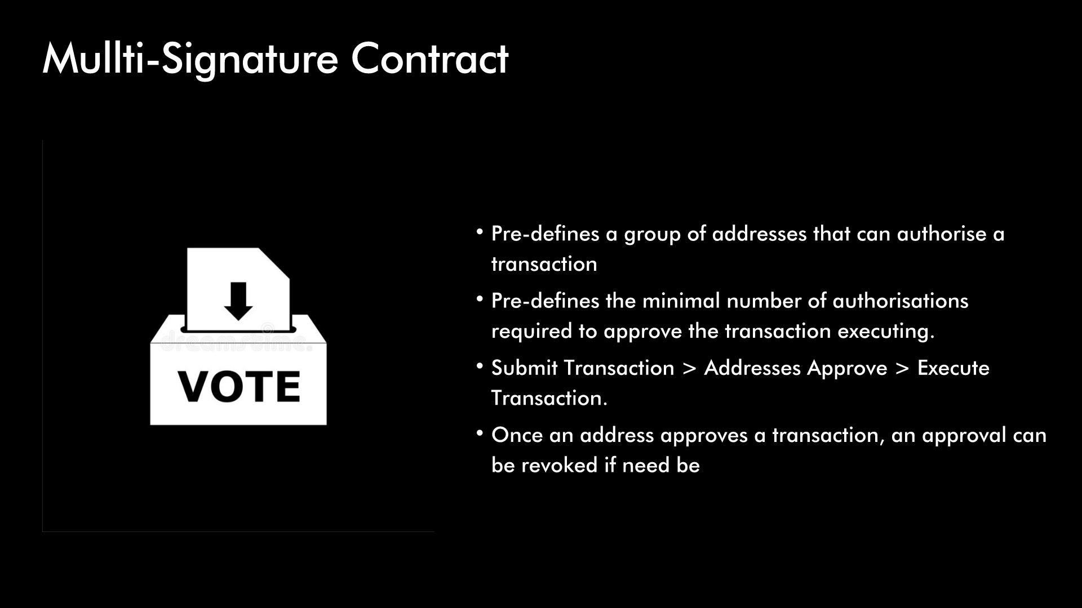


Notes:
Rae

Slide 10
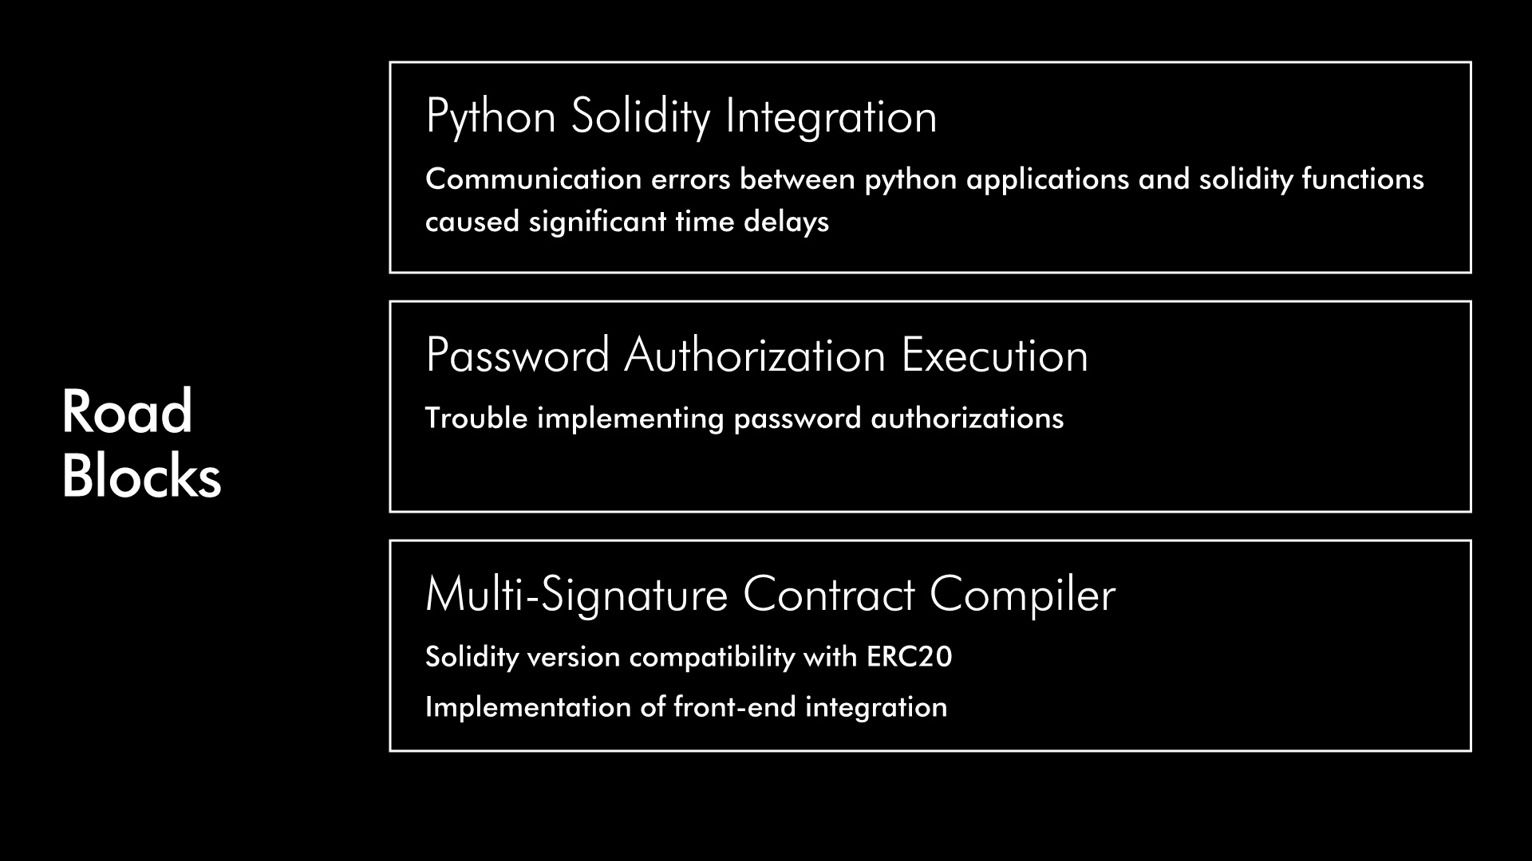
Notes:
Rae

Slide 11
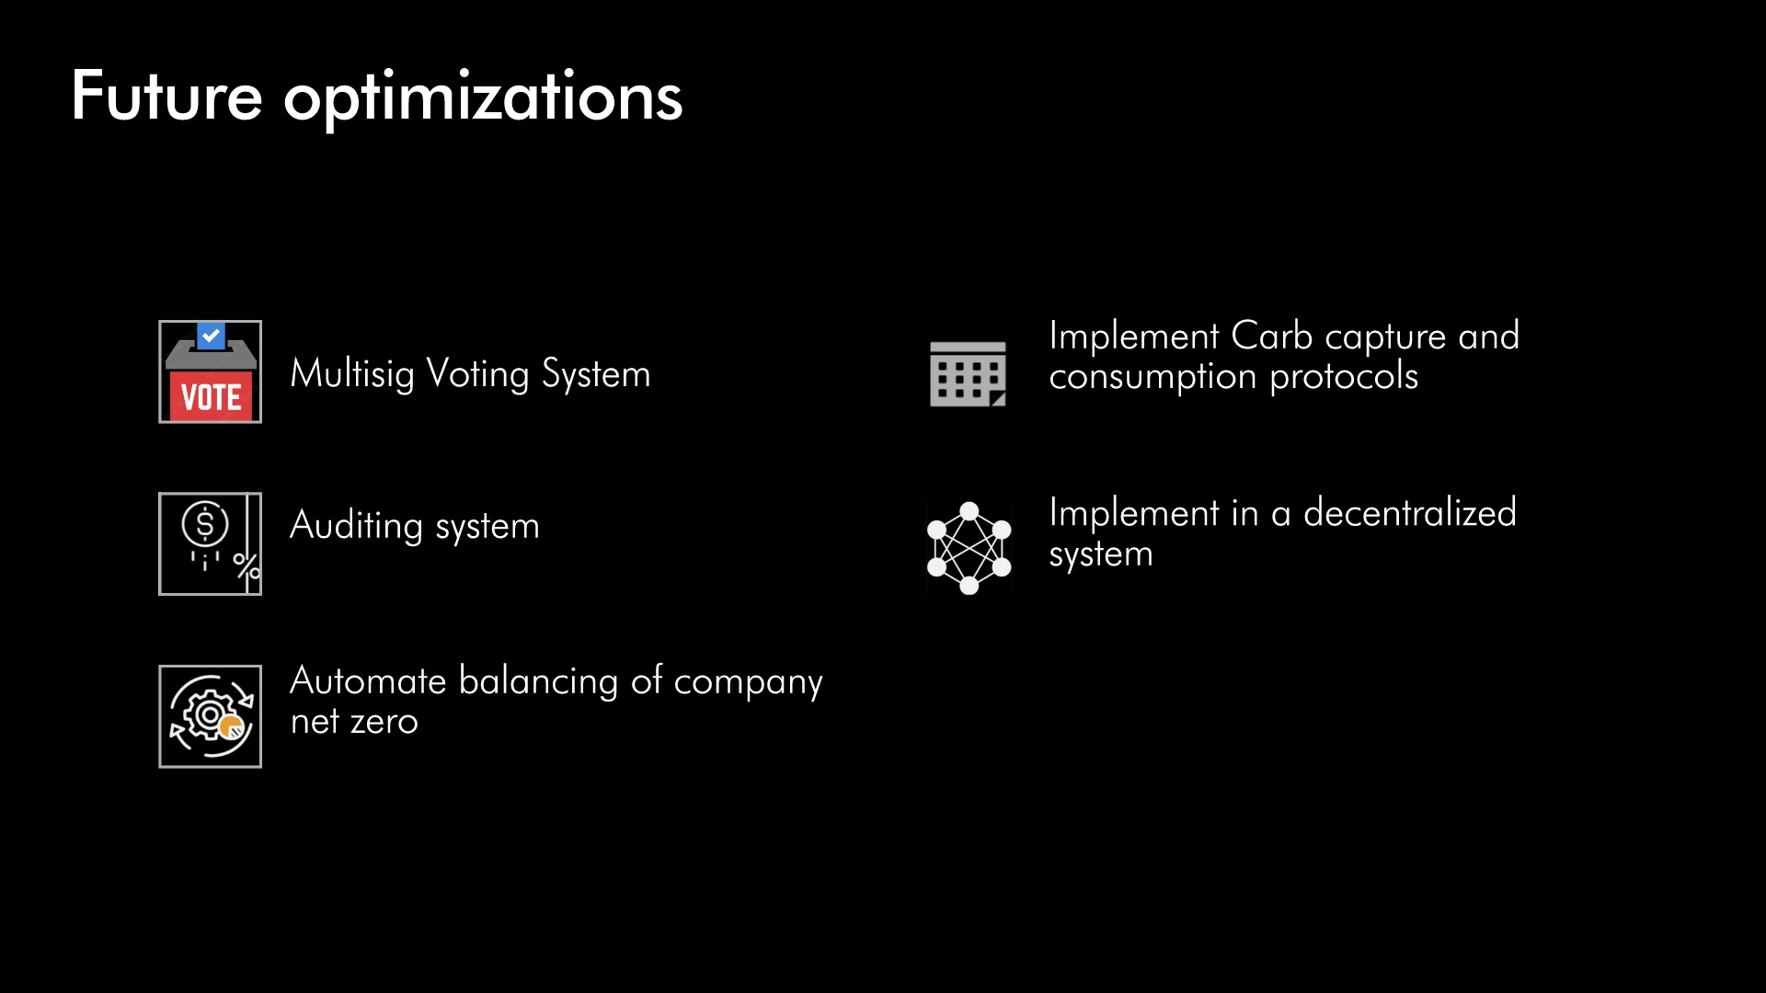
Notes:
Suraj

Slide 12

QUESTIONS
Github Repo : https://github.com/RPSangil/Project-3
Notes:
Suraj

